Slide 1

BIKE USER DEMAND STUDY Time, Weather, and Bike User Type Analysis
Swati Dwivedi Data Science Internship Programme
Nexthikes IT Solutions
20 January 2026

Slide 2
Key Objectives
Understanding demand variation by time, weather and user type.
Compare casual and registered user behavior.
Provide operational and strategic decision-making based on data for weather conditions and user-demand.

Slide 3
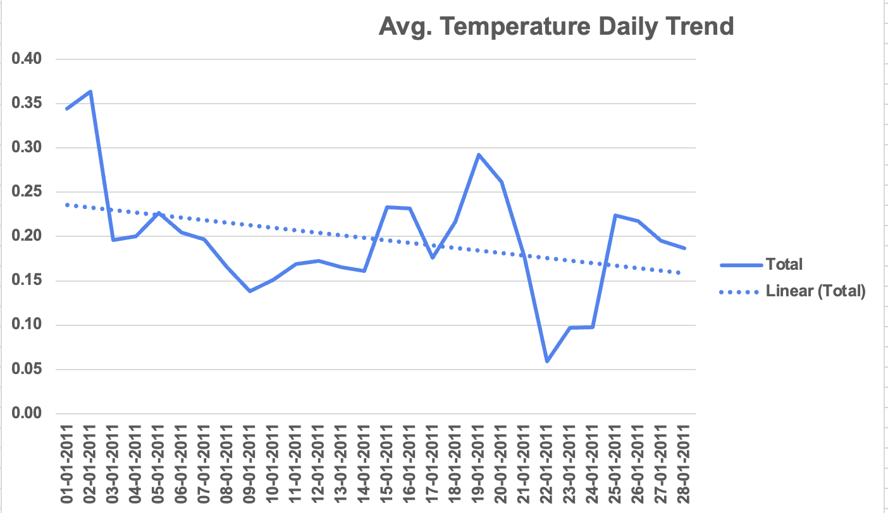
Key Finding from Dataset 1
Seasonal Trend and Weather Influence: January shows a general cooling pattern that is mainly influenced by weather conditions, not by the day of the week. Temperatures are highest at the beginning of the month, then drop sharply around January 21–22, and start to rise again after January 23.
Daily Fluctuations and Analytical Needs: During each day, temperatures are usually lowest in the early morning and highest in the afternoon. To clearly see these patterns without getting confused by hourly data, it helps to group the data using tools like pivot tables. This makes it easier to spot the morning lows and afternoon highs.

Slide 4
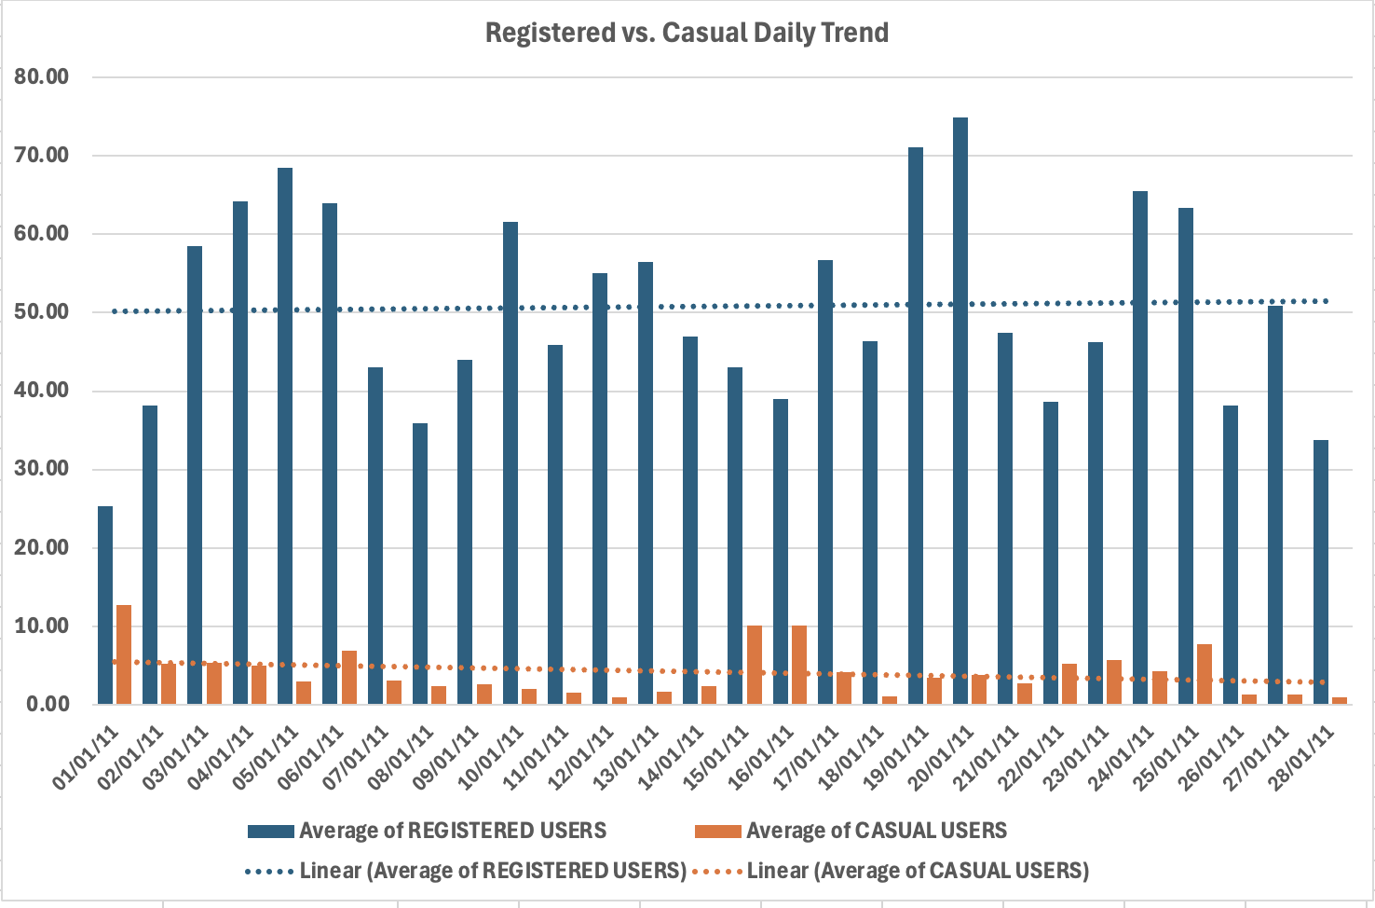
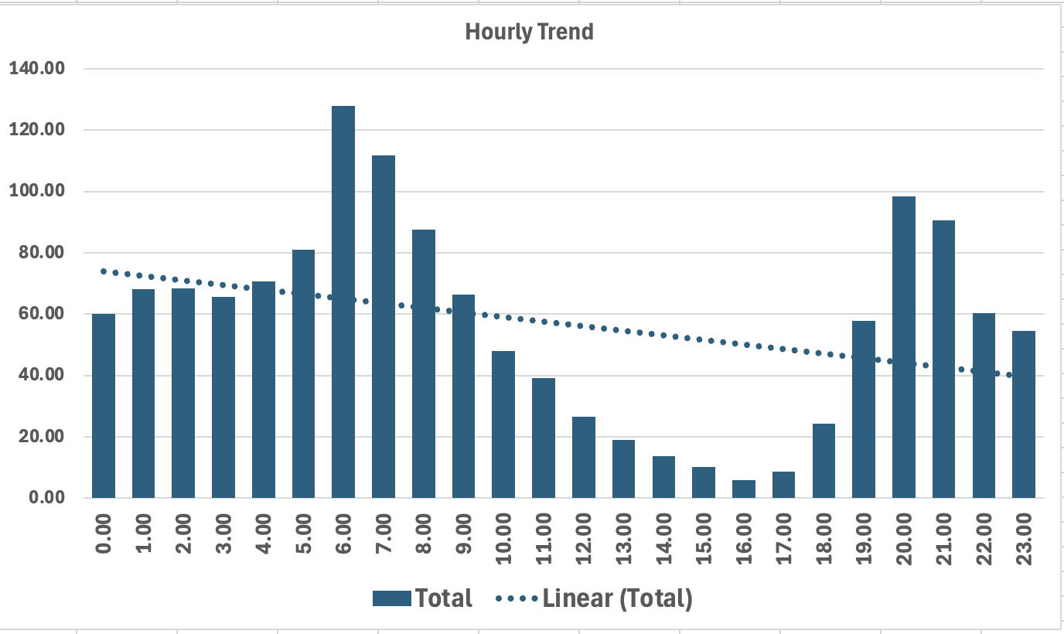
Key Finding from Dataset 2
Here is a User Loyalty vs. Timing: While total usage is showing a slight downward trend, your "Regulars" (Registered Users) are much more consistent and active than "Casual" riders. Interestingly, casual users tend to drop off significantly toward the end of the month. The data also shows occasional "strange spikes" or anomalies that break the normal pattern, suggesting that specific events sometimes override the general decline.
Commute Habits and Weather Power: Bike usage is heavily driven by two factors: the clock and the weather. There are clear "rush hour" peaks every morning and evening, likely due to people commuting to work. However, the overall seasonal trend shows that people are much more likely to ride when it is warm and the weather is good, proving that environmental conditions are a main driver of high demand.

Slide 5
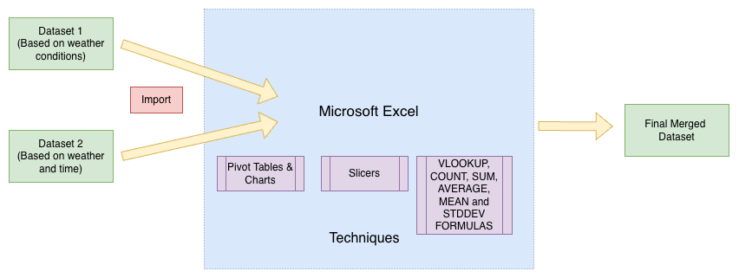
Methodology for Analysis

Slide 6
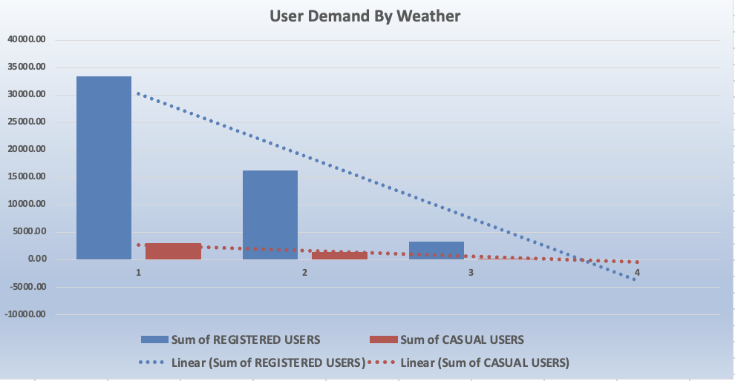
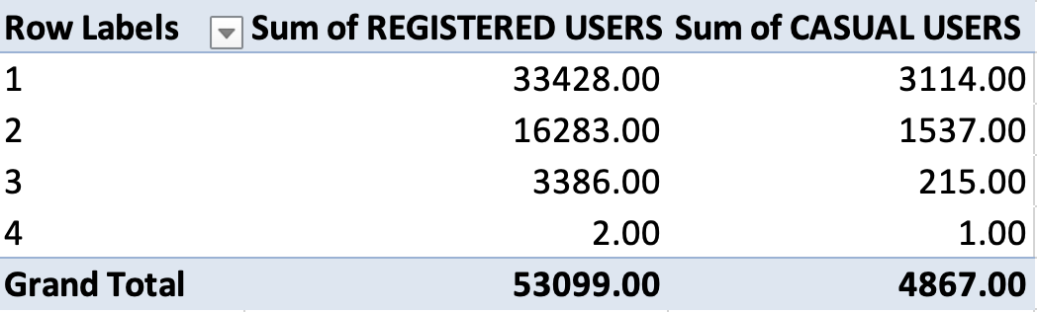
Key Findings based on Weather Condition
This chart presents total user demand segmented by prevailing weather conditions.
It shows proportional relationship between casual and registered users across different weather scenarios, emphasizing the increased participation of casual users during favorable weather and the stabilizing role of registered users during adverse conditions.
Highest usage in clear and mild weather.
Casual users are more weather-sensitive.

Slide 7
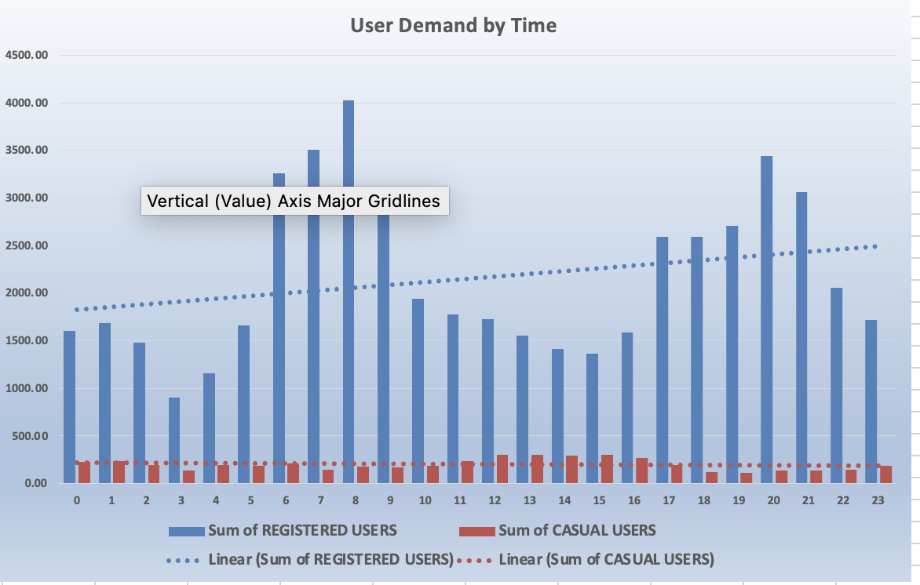
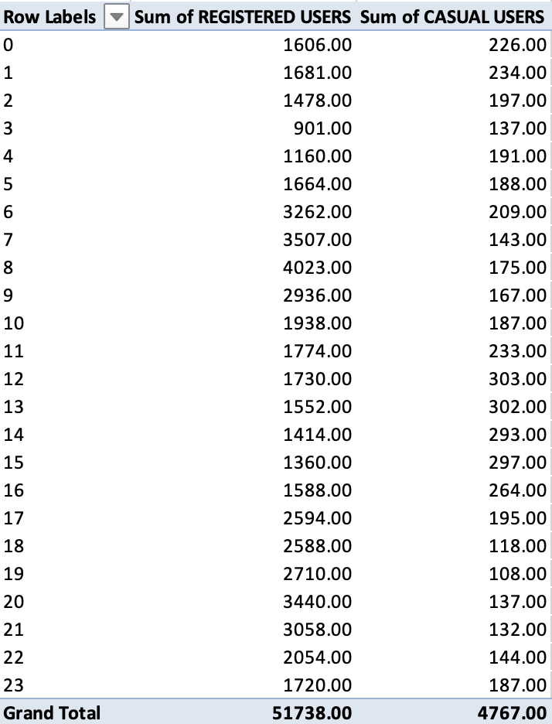
Key Findings based on Time
This figure compares hourly usage patterns between casual and registered users. Registered users exhibit consistent demand aligned with peak commuting times, whereas casual users show more variable usage patterns, particularly during off-peak and leisure periods.
User demand peaks during morning and evening hours, indicating strong commuting behavior.

Slide 8
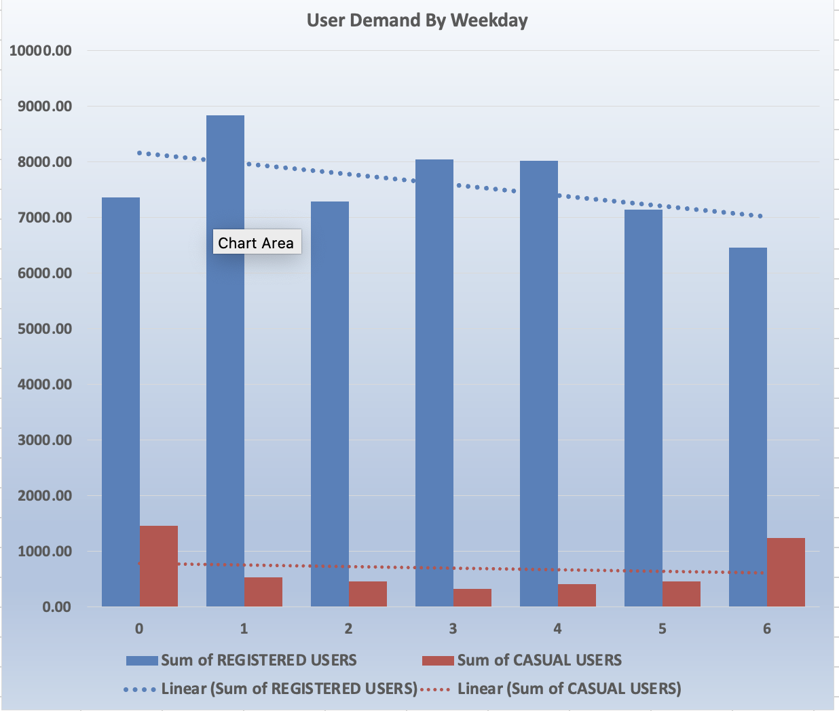
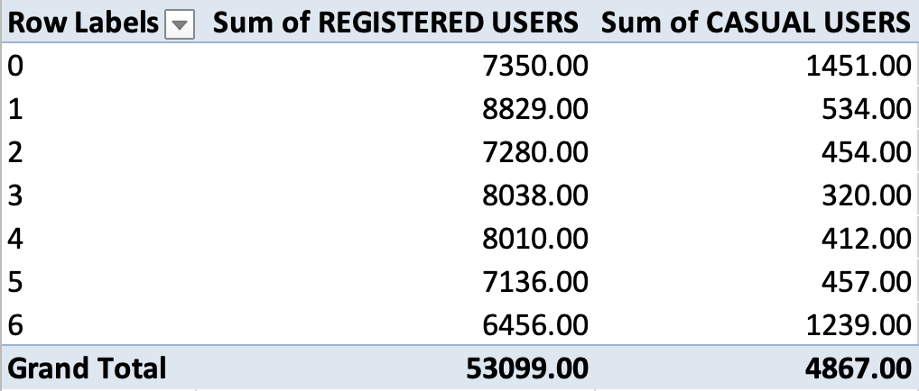
Key Findings based on User Behavior
This figure contrasts total demand between working days and non-working days. The analysis reveals stronger peak-hour demand on working days, while non-working days display a more evenly distributed usage pattern throughout the day.
Registered Users: Show consistent usage patterns, especially on working days and during peak commuting hours. This group appears to rely on the service for routine transportation.
Casual Users: Demand is more weather-sensitive and weekend-oriented, indicating usage for leisure or recreational purposes.

Slide 9
Business Insights
Commuter-Driven Demand: Usage is heavily concentrated in two daily windows: 7:00 AM – 9:00 AM and 5:00 PM – 8:00 PM. The data confirms the service functions as a daily transit utility rather than a leisure product.
Weather as the Primary Variable: Environmental conditions predict ridership more accurately than the day of the week. Clear weather correlates with high volume, while heavy rain or snow causes demand to vanish almost entirely.
Registered vs. Casual Stability: Registered users provide a stable revenue base during temperature drops. In contrast, casual users show low resilience, with their numbers falling sharply and staying low during cold-weather anomalies.
Mid-Day Utilization Gap: There is a consistent "valley" in demand during the middle of the day. The fleet remains largely inactive between the morning and evening rush hours regardless of the day type.
Sudden Weather Changes: Rapid, extreme temperature drops cause immediate ridership crashes. These sudden shifts have a more severe impact on daily totals than the general seasonal cooling trend.

Slide 10
Strategic Recommendations
Peak-Time Reliability for Registered Users Prioritize system reliability and service consistency during morning (7–9 AM) and evening (5–8 PM) peak windows to reinforce trust and habitual usage among registered users, ensuring a dependable commuting experience.
Weather-Triggered Casual Engagement Leverage favorable weather conditions as activation points for casual user outreach, promoting trial and short-term usage during clear and mild periods, while maintaining baseline service standards for registered users during adverse conditions.
Weekday Stability, Weekend Discovery Maintain performance and predictability during weekday commuting cycles to retain registered users, and position weekends and non-working days as discovery periods that encourage casual users to explore and engage with the service.
Progressive Conversion Pathways Establish structured engagement pathways that transition casual users into registered users through visible long-term value, recognition of repeated usage, and incremental benefits aligned with time- and weather-based usage patterns.

Slide 11
Future Scope
Better Demand Forecasting Use smarter tools to predict busy and slow periods by learning from past usage, time of day, and weather patterns.
Personalized User Messages Send users relevant updates and offers based on their past behavior, preferred times, and weather conditions.
Flexible Pricing and Promotions Introduce time-based or weather-based discounts to encourage casual users to try the service during low-demand periods.
Real-Time System Monitoring Track demand and service performance live to quickly respond to sudden changes such as peak-hour surges or bad weather.
User Conversion Tracking Monitor how casual users become registered users over time to understand what strategies improve long-term engagement.

Slide 12
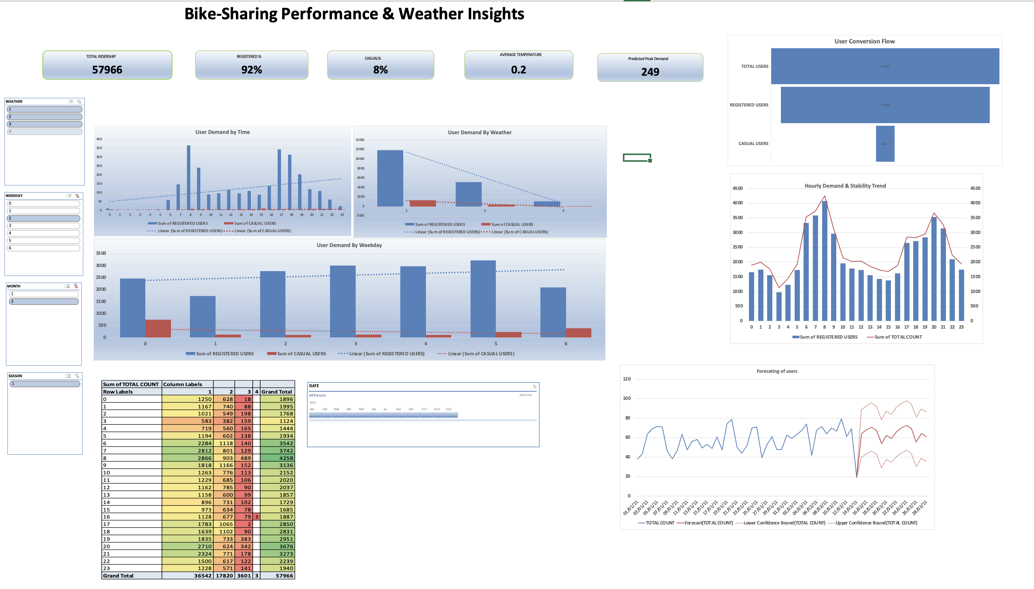
Bike-Sharing Performance & Weather Insights Dashboard

Slide 13
Challenges & References
Enabling and disabling the macro : link
Adding filtering and sorting actions to macro: link
Create automated dashboard: link
Add KPI metrics: link

Slide 14
Conclusion
Demand exhibits clear morning and evening peak hours driven primarily by registered users.
Casual users are highly sensitive to weather conditions and show increased usage during favorable weather and weekends.
Seasonal patterns indicate higher overall demand during warmer and mild periods.
Registered users provide a stable baseline of demand, while casual users represent growth opportunities.
Strategic alignment of operations, marketing, and forecasting can significantly enhance service efficiency and user engagement.

Slide 15
Thank You!

